Slide 1
Interfacing MQ7 sensor with
beaglebone
Sagar Pasricha (C0765531)
Notes:
1

Slide 2
Requirements for task
Beaglebone Black Wireless
MQ9 Sensor
Jumper wires
Laptop with Required Software
Node MCU

Slide 3
What is sensor?
A sensor is a device, module, machine, or subsystem whose purpose is to detect events or changes in its environment and send the information to other electronics, frequently a computer processor. A sensor is always used with other electronics.
A good sensor obeys the following rules:
It is sensitive to the measured property
It is insensitive to any other property likely to be encountered in its application
It does not influence the measured property.

Slide 4
What is gas sensor?
A gas sensor is a device which detects the presence or concentration of gases in the atmosphere.
Based on the concentration of the gas the sensor produces a corresponding potential difference by changing the resistance of the material inside the sensor, which can be measured as output voltage.
Based on this voltage value the type and concentration of the gas can be estimated.

Slide 5
Applications of Gas Sensors
Used in industries to monitor the concentration of the toxic gases.
Used in households to detect an emergency incidents.
Used at oil rig locations to monitor the concentration of the gases those are released.
Used at hotels to avoid customers from smoking.
Used in air quality check at offices.
Used in air conditioners to monitor the CO2 levels.
Used in detecting fire.
Used to check concentration of gases in mines.
Breath analyzer.

Slide 6
different types of Gas Sensors
Gas sensors are typically classified into various types based on the type of the sensing element it is built with.
Below is the classification of the various types of gas sensors based on the sensing element that are generally used in various applications:
metal oxide based gas sensor.
Optical gas sensor.
Electrochemical gas sensor.
Capacitance-based gas sensor.
Calorimetric gas sensor.
Acoustic based gas sensor.

Slide 7
Gas Sensors Construction
Of all the above-listed types, the most commonly used gas sensor is the Metal oxide semiconductor based gas sensor.
All Gas sensors will consist of a sensing element which comprises of the following parts.
Gas sensing layer
Heater Coil
Electrode line
Tubular ceramic
Electrode

Slide 8
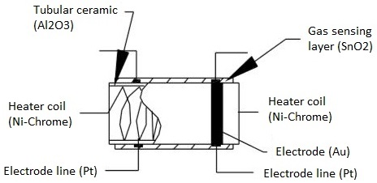
Gas Sensors Construction

Slide 9
Gas Sensors working
The ability of a Gas sensor to detect gases depends on the chemiresister to conduct current.
The most commonly used chemiresistor is Tin Dioxide (SnO2) which is an n-type semiconductor that has free electrons.
Normally the atmosphere will contain more oxygen than combustible gases.
The oxygen particles attract the free electrons present in SnO2 which pushes them to the surface of the SnO2.
As there are no free electrons available output current will be zero.
When the sensor is placed in the toxic or combustible gases environment, this reducing gas reacts with the adsorbed oxygen particles and breaks the chemical bond between oxygen and free electrons thus releasing the free electrons.

Slide 10
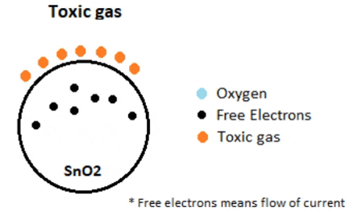
Gas Sensors working
As the free electrons are back to its initial position they can now conduct current, this conduction will be proportional the amount of free electrons available in SnO2, if the gas is highly toxic more free electrons will be available.

Slide 11
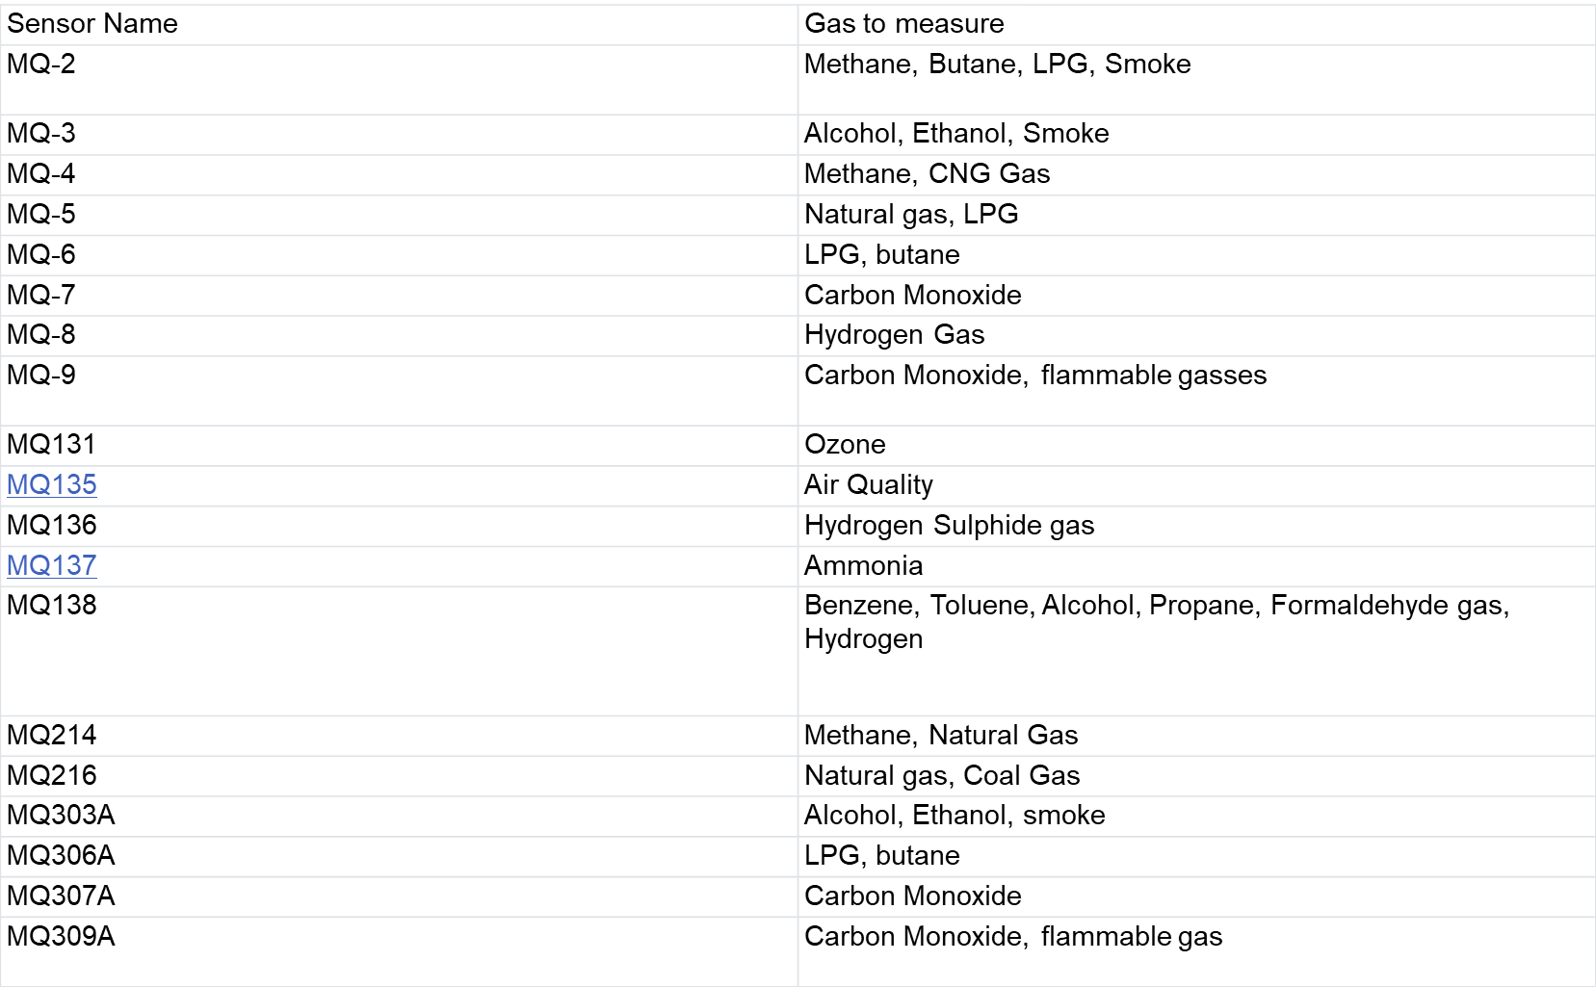
list of Gas Sensors and what they sense

Slide 12
Mq9 sensor
MQ-9 gas sensor has high sensitity to Carbon Monoxide, Methane and LPG.
The sensor can be used to detect different gases containing CO and combustible gases, it is low cost and suitable for different applications.
Sensitive material of MQ-9 gas sensor is SnO2, which has a lower conductivity in clean air.
It makes detection by cycling high and low temperature, and detects CO when low temperature (heated by 1.5V). The sensor’s conductivity is higher along with the gas concentration rising.
When high temperature (heated by 5.0V), it detects Methane, Propane etc combustible gas and cleans the other gases adsorbed under low temperature.

Slide 13
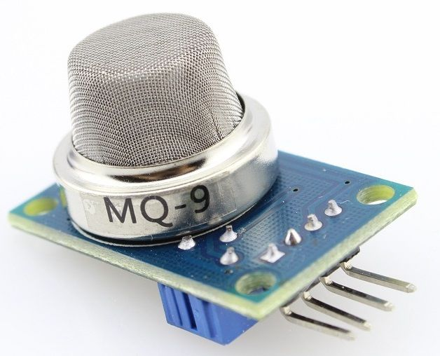
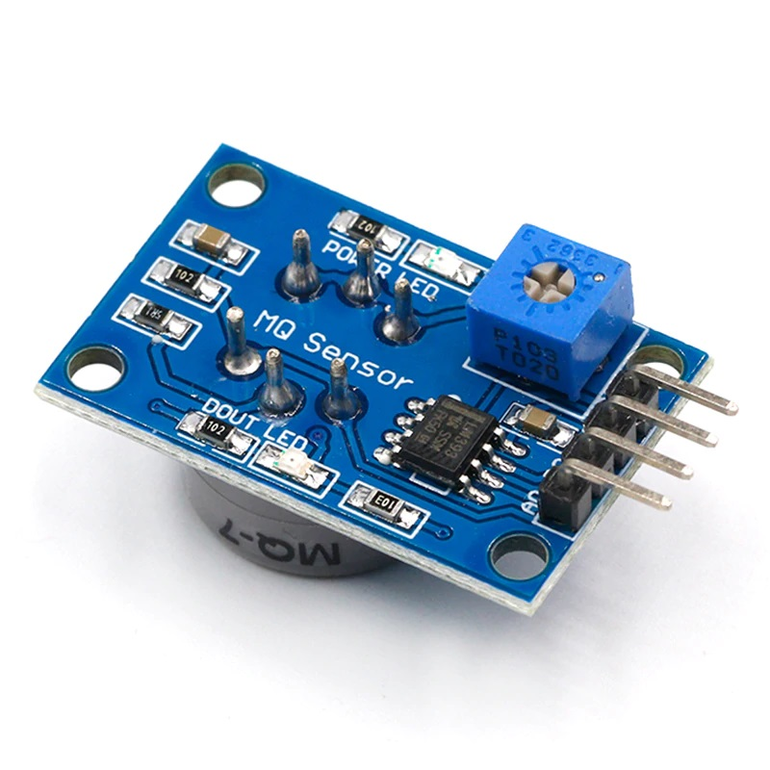
Mq9 sensor

Slide 14
Mq9 sensor
Specification:
Power supply needs: 5V
Interface type: Analog
Sensor Type: Semiconductor
Concentration:
10-1000ppm CO
100-10000ppm combustible gas
Good sensitivity to CO/Combustible gas
High sensitivity to Methane, Propane and CO
Long life and low cost

Slide 15
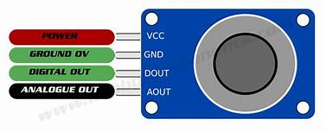
MQ9 PIN CONFIGURATION

Slide 16
MQ9 PIN CONFIGURATION
There 4 leads are +5V, AOUT, DOUT, and GND.
The +5V and GND leads establishes power for the alcohol sensor.
The other 2 leads are Aout (analog output) and Dout (digital output).
How the sensor works is the terminal Aout gives an analog voltage output in proportion to the amount of carbon monoxide the sensor detects. The more CO it detects, the greater the analog voltage it will output.
Conversely, the less CO it detects, the less analog voltage it will output.
If the analog voltage reaches a certain threshold, it will send the digital pin Dout high. Once this Dout pin goes high, the controller will detect this and will show a signal,

Slide 17
CALCULATION OF MQ7 SENSOR DATA
Each of the gas sensors outputs an analog value from 10 to 10000.
To convert this value into voltage, use the following equation.
Sensor Voltage = (dex * 5)/ 4095;
CO sensor: PPM = 3.027*exp(sensor_output*1.0698);

Slide 18
MQ9 SENSOR and beaglebone interfacing
Beaglebone | MQ9
PIN 40 (AIN 1) | AD0
VCC | VCC
GND | GND

Slide 19
esp32 and beaglebone interfacing
Beaglebone | ESP32
PIN 24 (UART_Tx) | D1
PIN 24 (UART_Rx) | D2
GND | GND

Slide 20
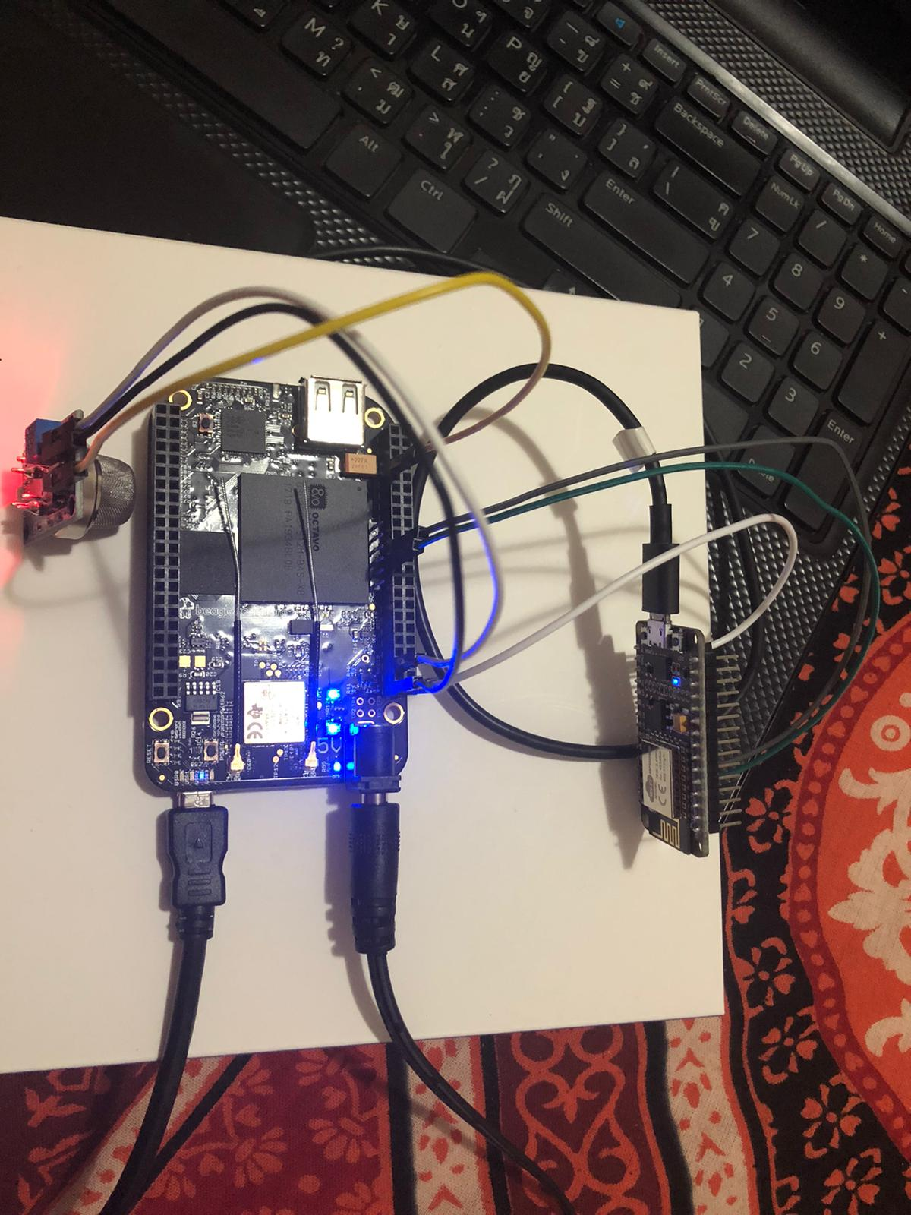
CONNECTIONs Image

Slide 21
CODE for arduino ide
#include <ESP8266WiFi.h>
#include <BlynkSimpleEsp8266.h>
#include <SoftwareSerial.h>
SoftwareSerial mySerial(D1,D2); // RX, TX
String recieve; //global string declaration for recieveing data
// You should get Auth Token in the Blynk App.
// Go to the Project Settings (nut icon).
char auth[] = "sEBpNn9m6oZd5h5-zHmFwhApmzI_c1fj";

Slide 22
CODE for arduino ide
// Your WiFi credentials.
// Set password to "" for open networks.
char ssid[] = "kalras";
char pass[] = "Moffatt27";
void setup()
{
// Debug console
Serial.begin(9600);
mySerial.begin(9600);
Blynk.begin(auth, ssid, pass);
}

Slide 23
CODE for arduino ide
void loop()
{
recieve=mySerial.readString();
Serial.println(recieve);
if(recieve=="alert")
{
Blynk.notify("Attention ! Gas Leakage.");
// Blynk.email("2262010929@fido.ca" , "Alert from Sensor " ,"There is gas leakage in restaurant");
}
Blynk.run();
delay(2000); // delay of 60s
}

Slide 24
CODE for beaglebone
#include <iostream> //provides basic input and output services for C++
#include <unistd.h> //provides access to the POSIX operating system API. #include <fstream> //performs input/output operations on the file
#include <math.h> // for mathematical operation
#include <stdio.h> //defines various functions for input output operations
#include <fcntl.h> //Used to define arguments for open ,close functions #include <unistd.h> //This is for misscelaneous functions declaration
#include <termios.h> // It contains the definitions used by terminal input output interfaces
#include <string.h>
#include <cstring>

Slide 25
CODE for beaglebone
using namespace std;
int sensor_val() // generating a temerture function
{
int Smoke_sensor; // generating a local variable
fstream f; // generating a stream for file f.open("/sys/bus/iio/devices/iio:device0/in_voltage1_raw"); // config P9_40 AIN of BBBW
f>>Smoke_sensor; // giving file address to local variable
return (int)Smoke_sensor; //returning integer value to getTemp function
}

Slide 26
CODE for beaglebone
int main()
{
float dex,sensor_output,b;
int file, count, pin_number;
file = open("/dev/ttyO1", O_RDWR); //this function open the file associated with Uart1
struct termios options; //declaration of a struct options
tcgetattr(file, &options); //This function get parameters associated with terminal and store them in termios
options.c_cflag = B9600 | CS8 | CREAD | CLOCAL;
options.c_iflag = IGNPAR | ICRNL;
tcflush(file, TCIFLUSH); //This function is used to clear input and output queue associated with terminal files
tcsetattr(file, TCSANOW, &options);

Slide 27
CODE for beaglebone
char receive[] = "alert"; //recieve array declaration
while(1) {
dex= sensor_val();
sensor_output = (dex * 5)/ 4095; sensor_output=3.027*exp(sensor_output*1.0698);
cout<<"CO Sensor Reading : " << (int)sensor_output<<" ppm"<<endl; if((int)sensor_output > 620)
cout<<“Gas Leakage Alert” endl; {
write(file, receive, strlen(receive));
}
system("sleep 2"); // putting system to sleep
}
return 0;
}

Slide 28
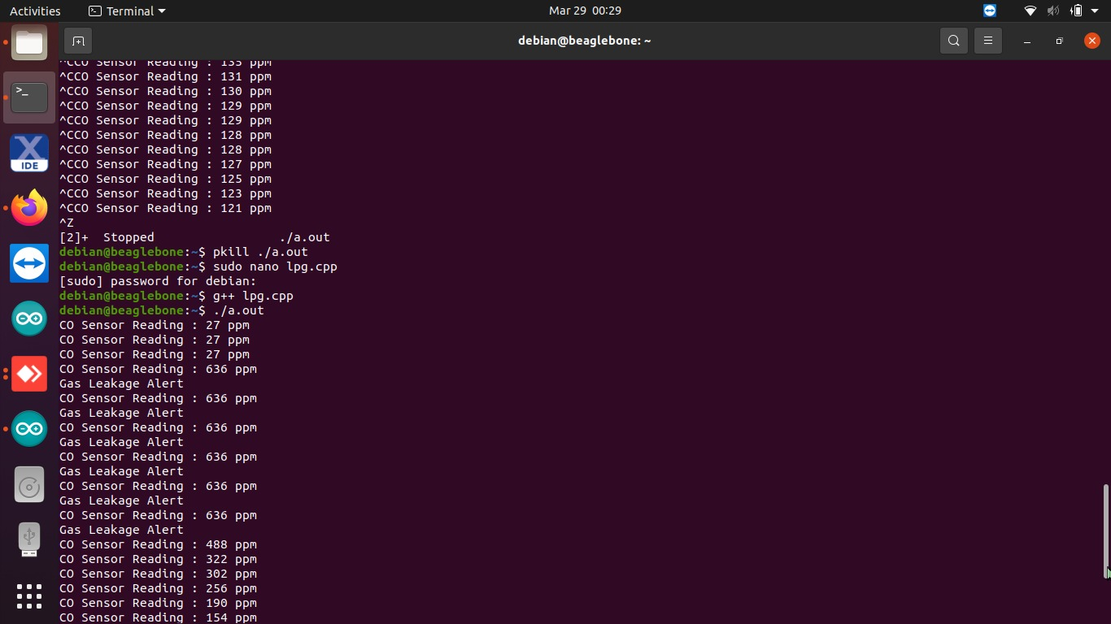
Sensor detection OUTPUT

Slide 29
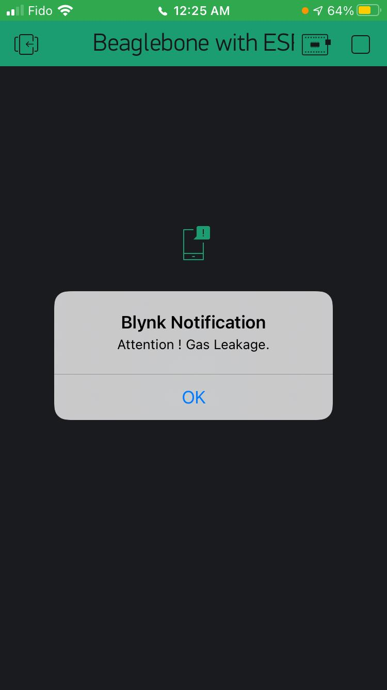
Notification on Blynk

Slide 30
references
What is sensor?. Retrieved from en.wikipedia.org
https://en.wikipedia.org/wiki/Sensor
Introduction of gas sensor. Retrieved from components101.com
https://components101.com/articles/introduction-to-gas-sensors-types-working-and-applications
Introduction of MQ9 sensor. Retrieved from dfrobot.com
https://wiki.dfrobot.com/Analog_Gas_Sensor_MQ9__SKU_SEN0134
MQ9 Pin Configuration. Retrieved from learningaboutelectronics.com
http://www.learningaboutelectronics.com/Articles/MQ-7-carbon-monoxide-sensor-circuit-with-arduino.php
Calculation for MQ9 Sensor Data. Retrieved from tutorialspoint.com
https://learn.sparkfun.com/tutorials/hazardous-gas-monitor/calculate-gas-sensor-ppm

Slide 31
Any questions?

Slide 32
Thank you

